Slide 1
New Kid on the Block
Walter Elias Disney: The Early Years
Notes:
This is a test – can I read this in “Play” mode?

Slide 2
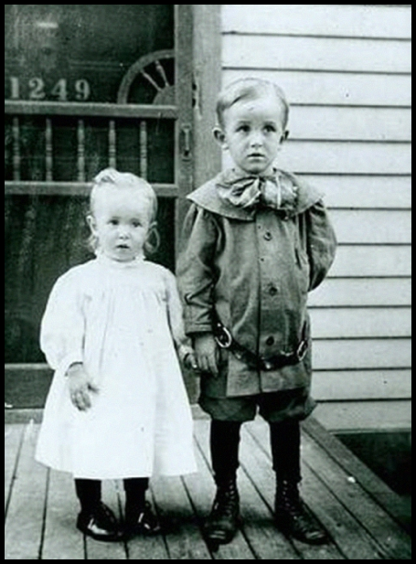
Born December 5, 1901

Slide 3
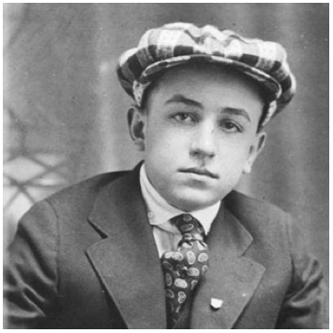
Showed an early interest in the arts: drawing and acting.

Slide 4
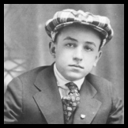

Elias Disney was not financially successful.
Tried various trades.
After selling his Marceline, Missouri Farm, family moved to Chicago.
Acquired a paper route as a principle source of income.
Walt and his brother were delivery boys.

Slide 5
Elias Disney wasn’t supportive of his son’s interests in the arts.
Walt looked to Roy for comfort and companionship.

Slide 6
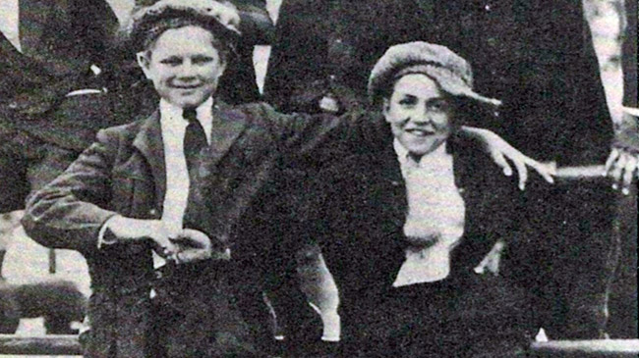
Childhood friend with mutual interests.
Would sneak out of his bedroom, interact with his neighborhood friend, Walter Pfeiffer, then climb back in his bedroom window a few hours before he had to go deliver papers.

Slide 7
Sold drawings at a local barber shop.
Started classes at the Chicago Institute of Art.

Slide 8
Sold drawings at a local barber shop.
Started classes at the Chicago Institute of Art.
US enters WWI, Roy enlists.

Slide 9
Walt lies about his age and tries to join the Army.

Slide 10
Walt lies about his age and tries to join the Army.
His true age is discovered and he is sent home.

Slide 11
Walt lies about his age and tries to join the Army.
His true age is discovered and he is sent home.

Slide 12
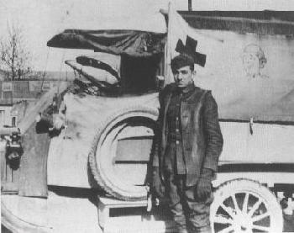
Talks his mom into signing a release so that he can join the Red Cross and drive an ambulance to support the war effort.

Slide 13
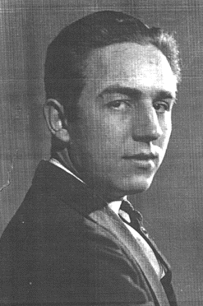
Returns to K. C., finds employment with Pesmin-Rubin Commercial Artists.

Slide 14
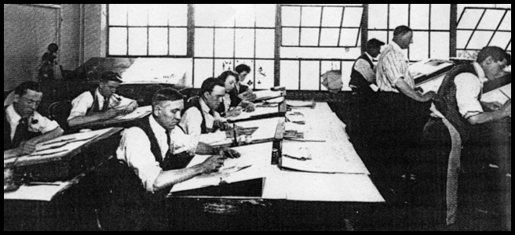
Meets Ubbe Iwwerks at Pesmin-Rubin.

Slide 15
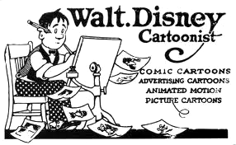
Open A Commercial Art Studio.

Slide 16
Out of Money, Out of Business

Slide 17
Kansas City Film Ad Co.

Slide 18
Kansas City Film Ad Co.
Helps Ub land a job
Introduced to Filmmaking World
And …. Limited Animation Used in Ad Production

Slide 19

Kansas City Film Ad Co.
Acquires Animated Cartoons by Edwin George Lutz from the public library

Slide 20
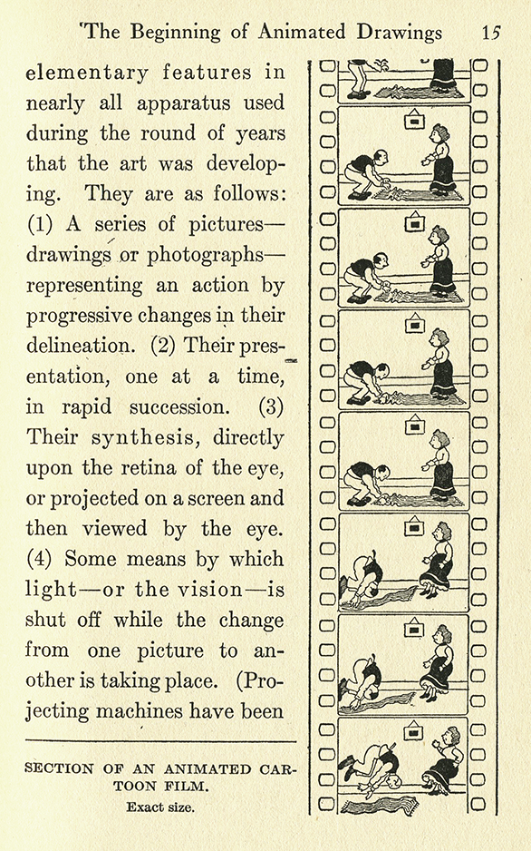
Kansas City Film Ad Co.

Slide 21
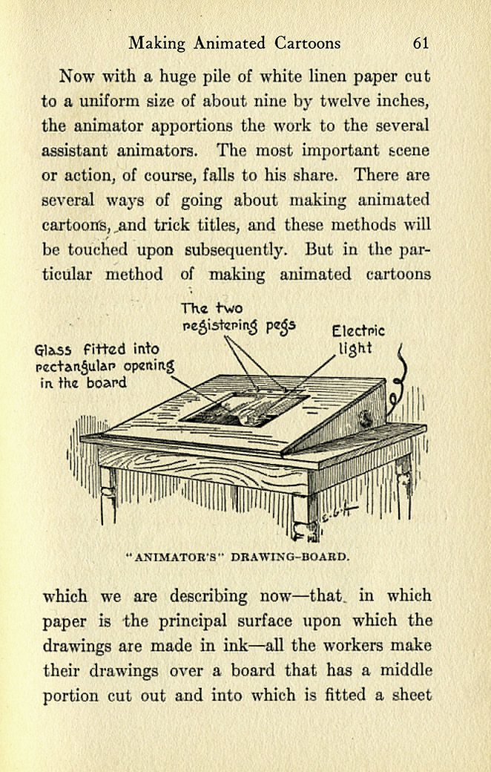
Kansas City Film Ad Co.

Slide 22
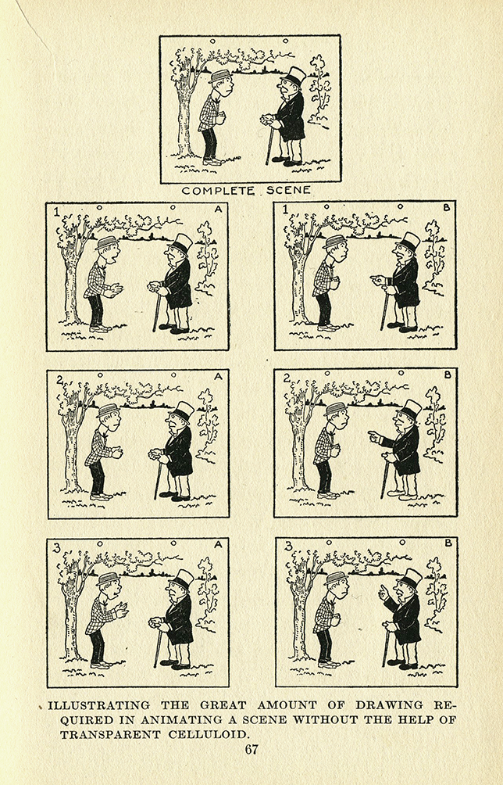
Kansas City Film Ad Co.

Slide 23
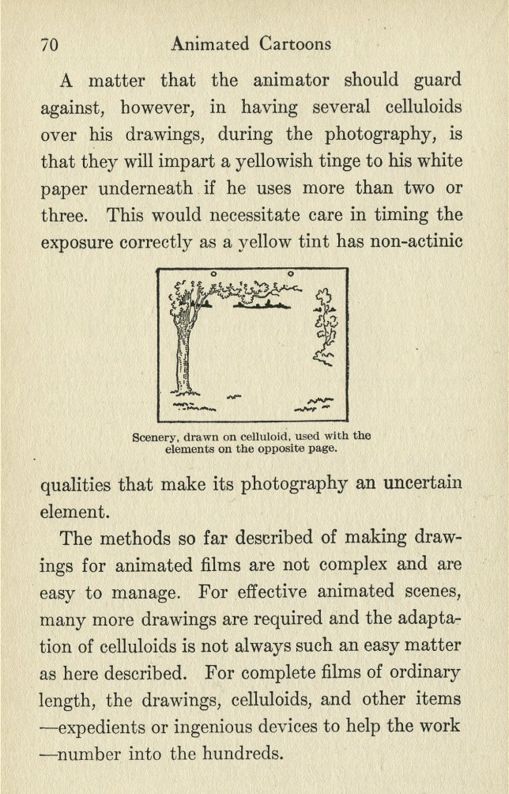
Kansas City Film Ad Co.

Slide 24
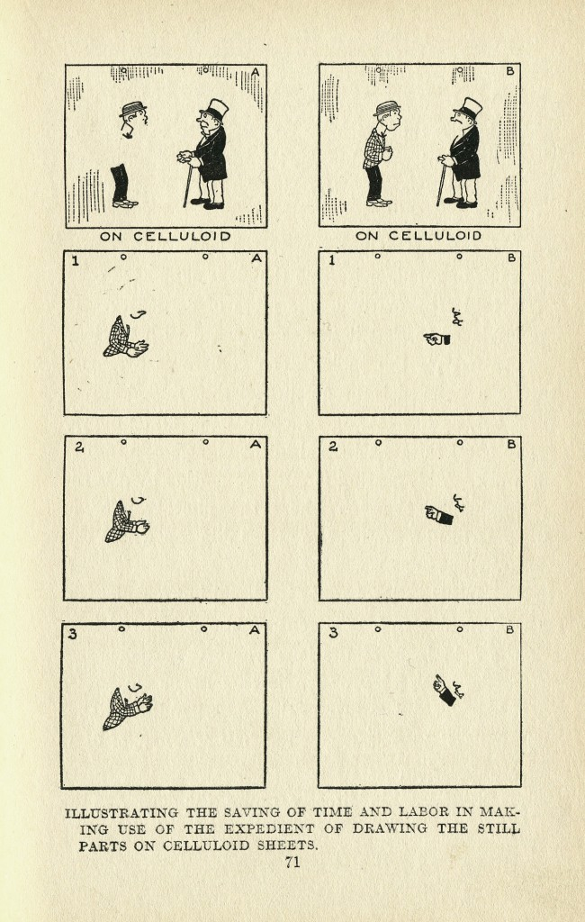
Kansas City Film Ad Co.

Slide 25

Kansas City Film Ad Co.

Slide 26
Kansas City Film Ad Co.
Borrows a camera
Walt & Ub work late nights and weekends

Slide 27
Kansas City Film Ad Co.
Lands an $11,000 contract from Pictoral Films
A Strange Contract: Payment to come six months after delivery.

Slide 28
Kansas City Film Ad Co.
Lands an $11,000 contract from Pictoral Films
A Strange Contract: Payment to come six months after delivery.
Starts a New Business: Laugh-O-Grams

Slide 29
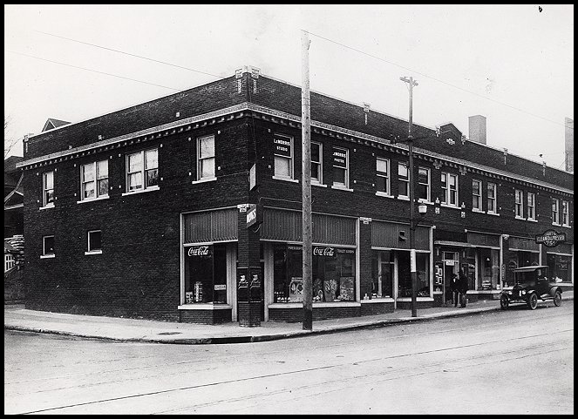
Laugh-O-Grams

Slide 30
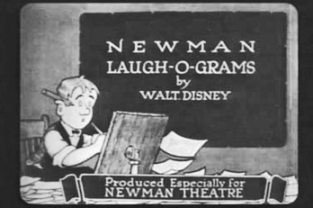
Laugh-O-Grams

Slide 31
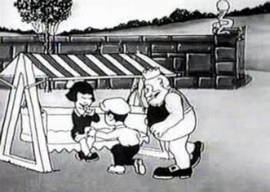
Laugh-O-Grams
Produced fairy tails and parables

Slide 32
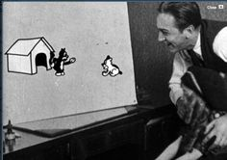
Laugh-O-Grams
Produces the first Alice Comedy

Slide 33
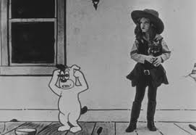
Laugh-O-Grams
But it bankrupts the company

Slide 34
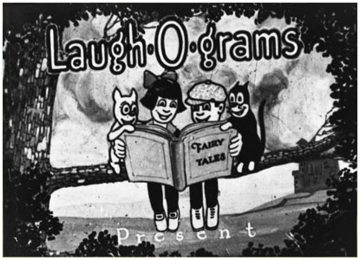
Laugh-O-Grams Folds Out of Business Again

Slide 35
Twice failed in business, owes money to friends and relatives, this could be the end of his adventures in the entertainment industry….but he has a gift, and one asset – the first finished Alice film.

Slide 36
His Gift:
“Perhaps no one in the history of film has had as thorough an understanding of story structure and pacing as Walt Disney”
- Charles Solomon

Slide 37
So he heads west, to Hollywood, dirt poor with a borrowed coat, a cardboard suitcase and holes in his shoes.

Slide 38
Walt to M.J. Winkler:
“We have just discovered something new and clever in animated cartoons!
The first subject of this distinctly different series is now in production.
It is a new idea and is bound to be a winner because it is a clever
combination of live characters and cartoons using a cast of live child
actors who carry on their action on cartoon scenes with cartoon characters.”

Slide 39
Walt to M.J. Winkler:
“I am establishing a studio in Los Angeles and am taking with me a select number
of my former staff and will in a short time be producing at regular intervals.”

Slide 40
Walt to M.J. Winkler:
“I am establishing a studio in Los Angeles and am taking with me a select number
of my former staff and will in a short time be producing at regular intervals.”
⬥  
“Believe series can be put over will pay fifteen hundred each negative for first six.”

Slide 41
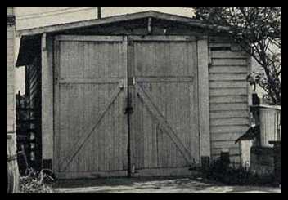
Walt’s Studio, in uncle Roberts’ Garage

Slide 42

Walt’s Studio, in uncle Roberts’ Garage

Slide 43
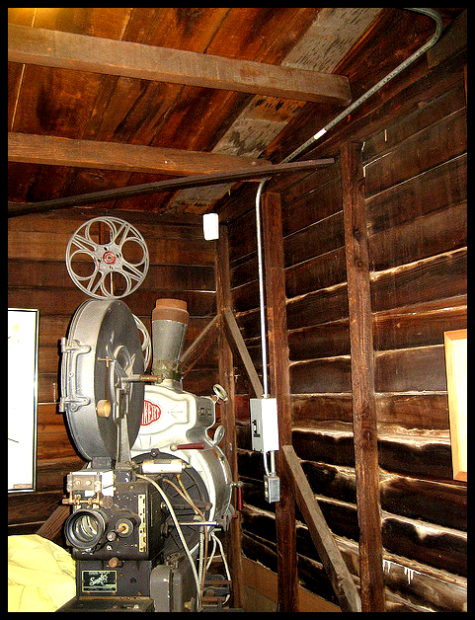
Walt’s Studio, in uncle Roberts’ Garage

Slide 44
Disney Bros. Begins Production
Opens Studio in mid October, 1923
Convinces Roy to Join Him
Hires Ham Hamilton
Sends for Virginia Davis, at $100.00 a month
Asks Ub Iwerks to leave K.C. and come to California

Slide 45
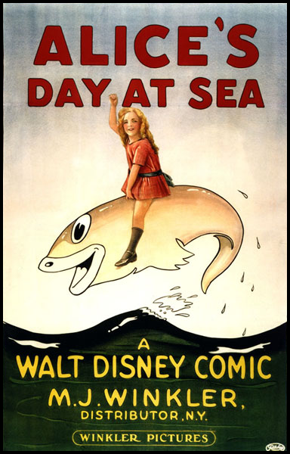
Disney Bros. Begins Production
Released by Christmas 1923

Slide 46
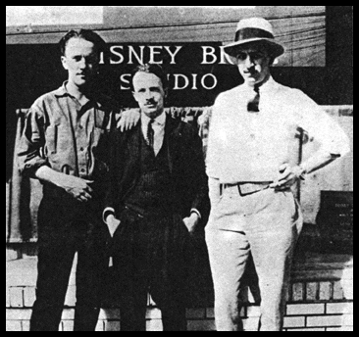
“It didn't take very many people to produce animated cartoons in the early 20s. Walt Disney, 23, poses outside of his small studio on Kingswell Ave. in Los Angeles with Ub Iwerks (left) and Ham Hamilton (center), both animators. Two girls worked in ink-and-paint, Mike Marcus operated the camera and Walt's older brother Roy handled the books and ran the camera for the live-action filming of the 5 year-old actress, Virginia Davis, who played Alice.”
© The Walt Disney Company

Slide 47
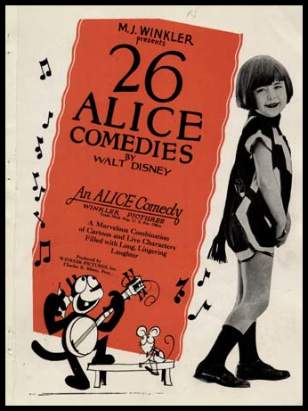
$1,500 each for the first 6, then two more series at $1,800 each.

Slide 48
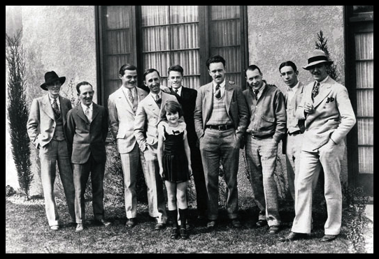
Disney Brother’s Studio & the Alice Staff, 1927

Slide 49
L to R: Walker Harmon, Friz Freleng, Rudolph Ising,
Roy Disney, Lois Hardwick, Hugh Harmon, Ub Iwerks,
Norman Blackburn, Paul Smith, Walt Disney

Slide 50

Oswald the Lucky Rabbit, 1927

Slide 51
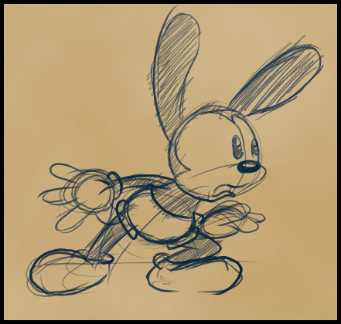
Iwerks redesign was rounder

Slide 52


Comparative Design: Oswald and the Animaniacs

Slide 53

Oswald’s popularity begins to grow…things look good for Disney’s fledging studio.

Slide 54
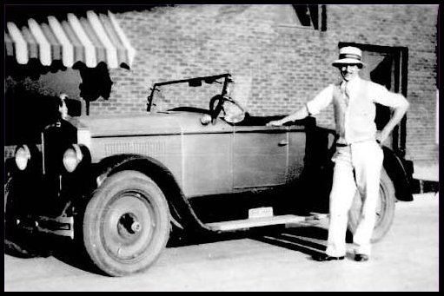
Walt’s one obsession purchase

Slide 55
Mintz
Charles Mintz takes over the business operations for Winkler, his wife.
At contract’s end, Mintz was paying Disney $2,250.00 per cartoon
Walt wanted $2,500.00
Mintz final offer was $1,800.00
… or loose his Oswald character altogether

Slide 56
The Coming of Mickey
Telegram to Roy and Ub: Everything will be OK.

Slide 57
The Coming of Mickey
Ideas began on the train from New York to L.A.
Continued development after his return
Mortimer was his suggested name
Lilly (by most accounts) thought Mickey was better

Slide 58
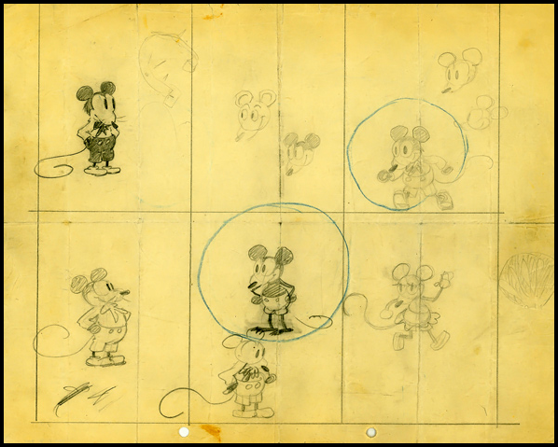
The Coming of Mickey

Slide 59
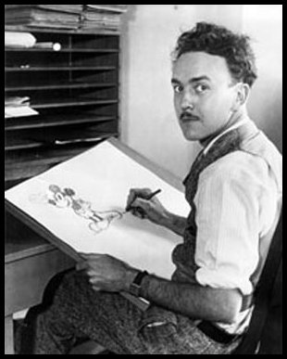
The Coming of Mickey
Ub

Slide 60
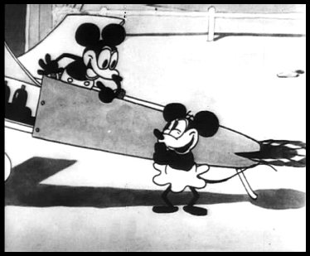
Plane Crazy
Premiered May, 1928

Slide 61
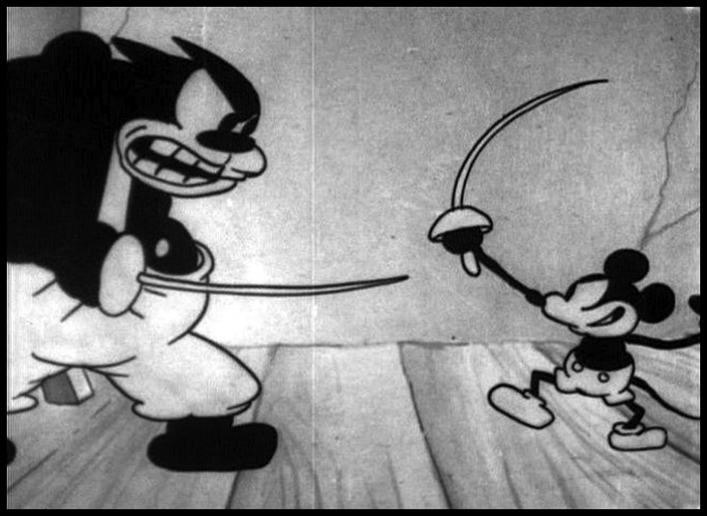
Galloping Gaucho
August, 1928

Slide 62
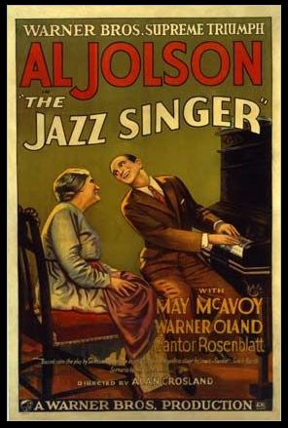
The Jazz Singer, Oct ‘27

